Slide 1

Notes:
Humanity is diverse and beautiful because of it. See if you can find your flag!

Slide 2

What brings all of humanity together?
How could we see ourselves as a single entity?
Do you think of our commonalities?
Do you think of our differences?
Is it language?
Mass / social media?
Perhaps you think of technology?
What about our shared global goals / problems?
Notes:
Are we beginning to unite?

Slide 3

International Flag of Planet Earth
Reflect on the impact of A.I. on our society.
Are we preparing our students for -
The Singularity?
Globalization?
A brand new economy?
What about successful convergence with A.I.?
AI4K12 is more than just playing with computers, robots, and growing expertise. We have to prepare our students for a changing world. A.I. will change all subjects, not just math / science.

Slide 4
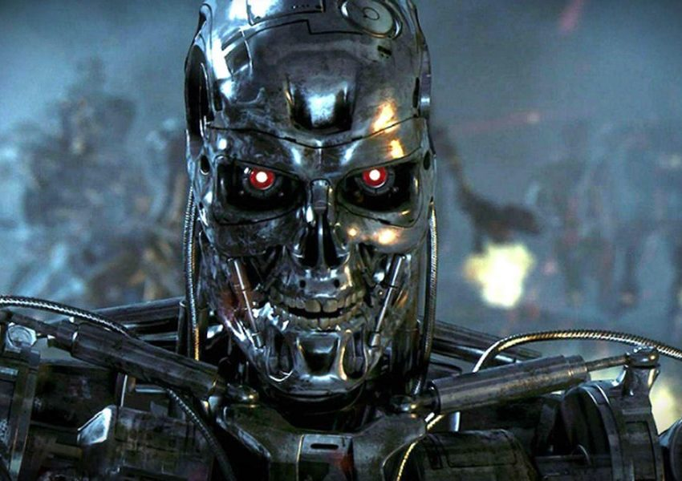
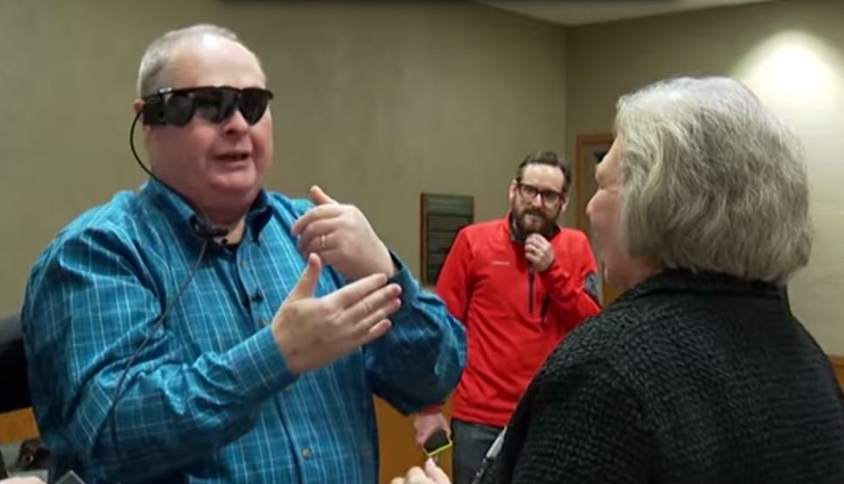
Technology & A.I. - The Ultimate Unifying Factor
We must learn to compete...
Or learn to converge...
Notes:
A.I. poses the greatest existential threat to humanity. However, it can also be the ultimate unifying factor. Nothing unites us more than a common threat. What if we can converge instead of compete?

Slide 5
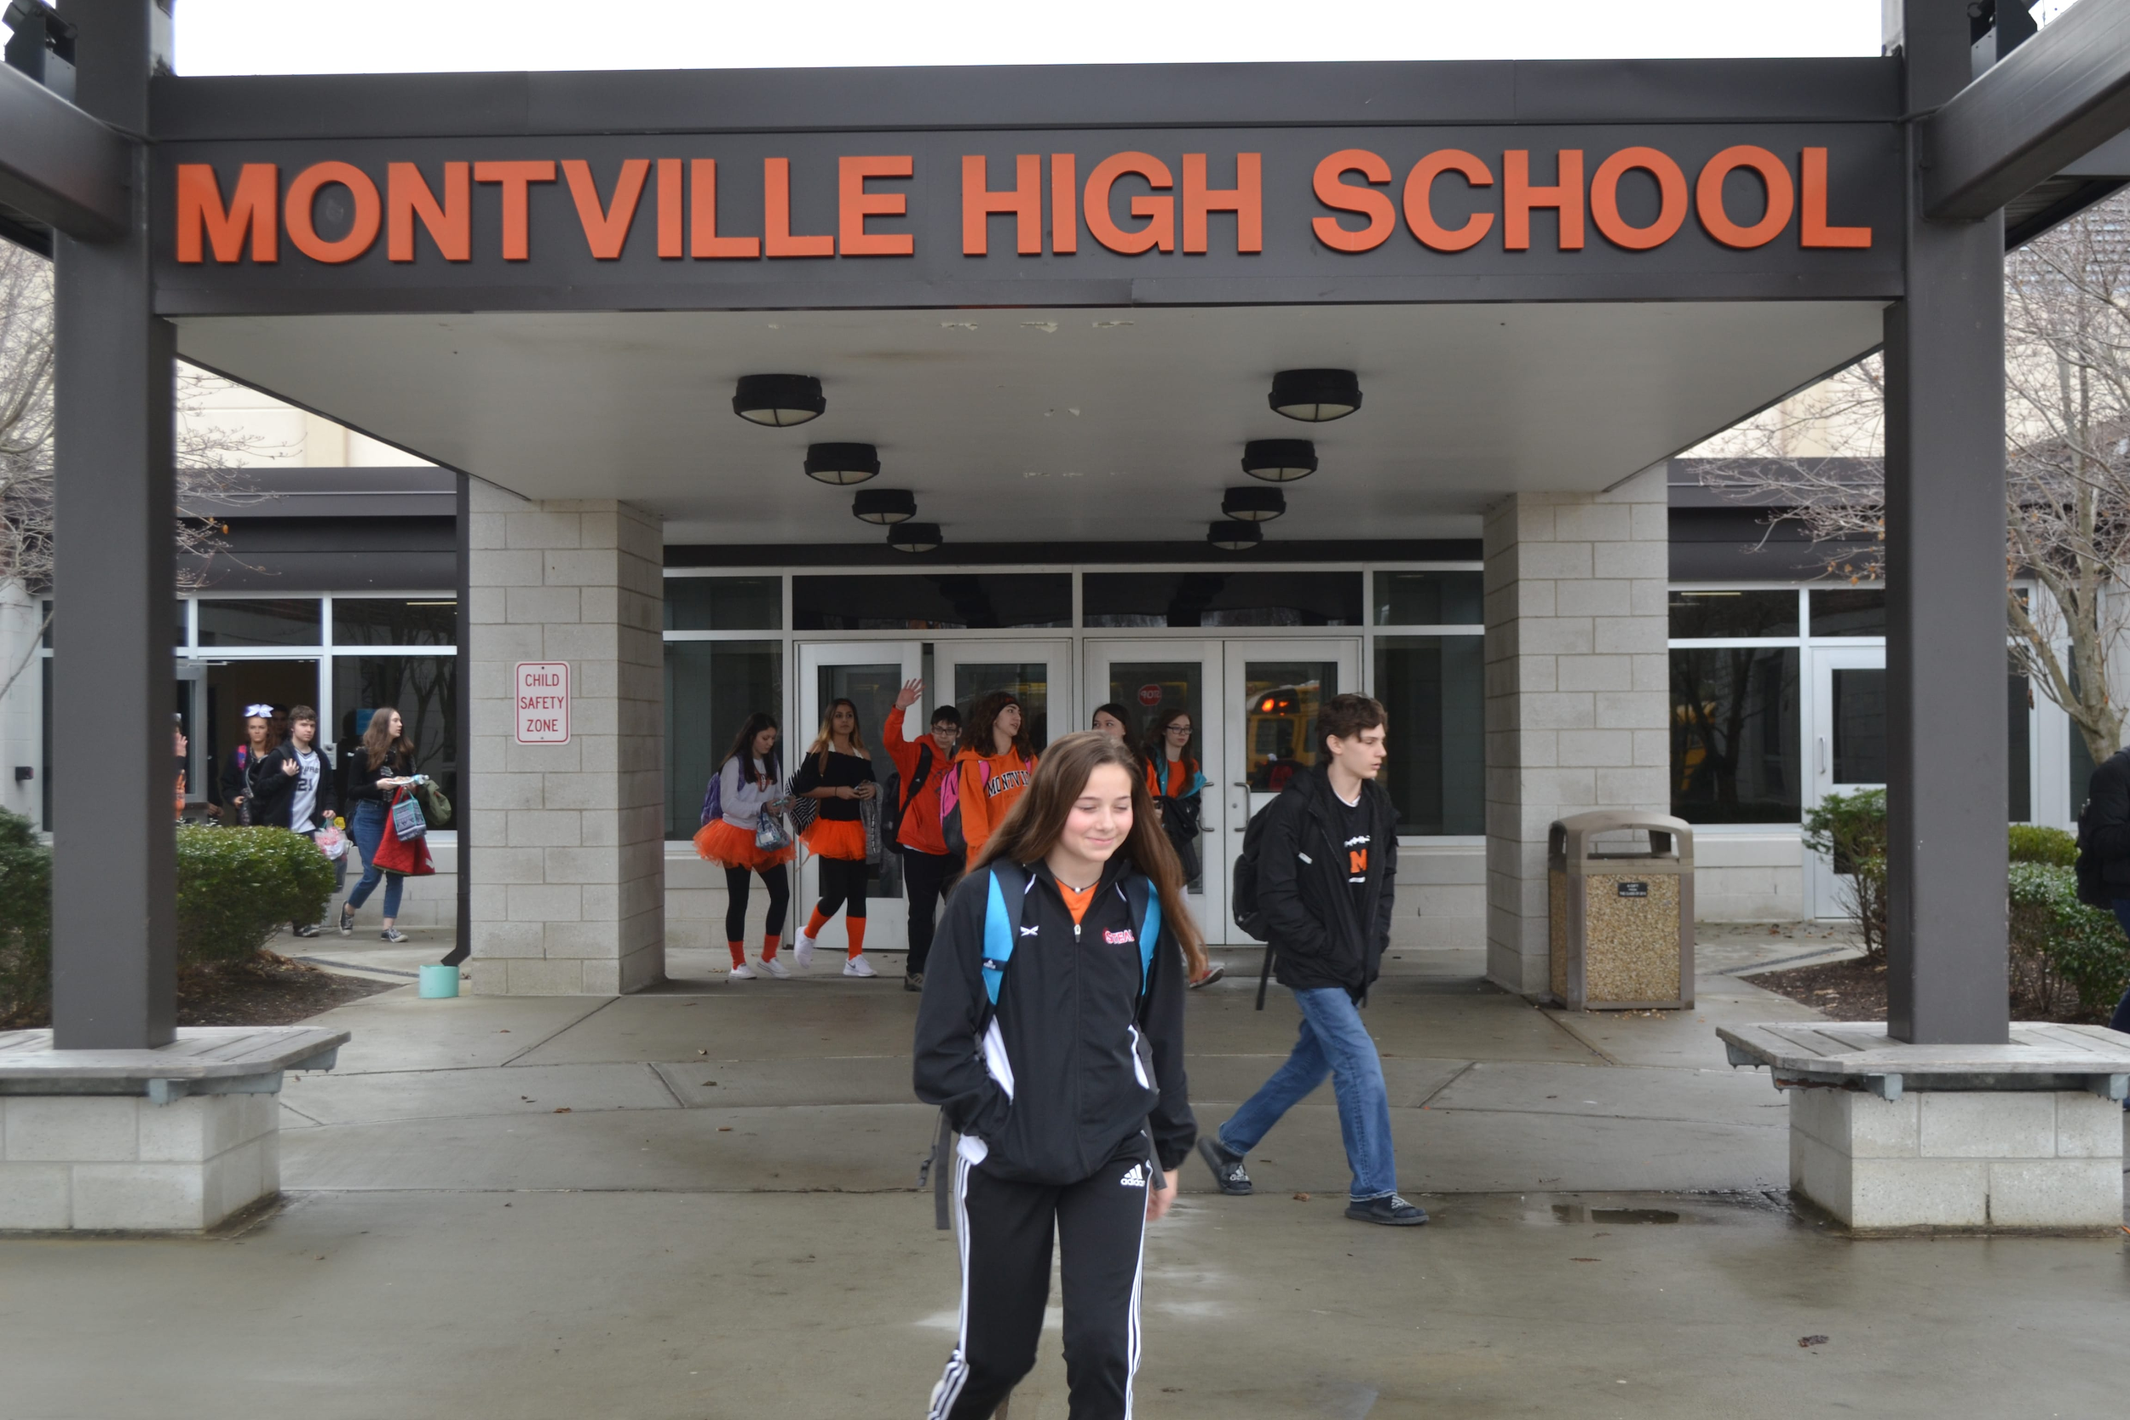
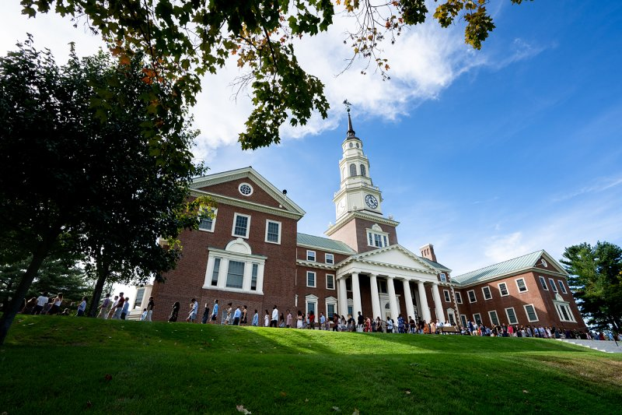
And where do most learn best?
92% of Americans age 25 and older have Graduated High School
35% of Americans age 25 and older have graduated with a BA

Slide 6
Barriers to Convergence With A.I. - K-12
Outdated testing techniques - How do we assess our students? How does this impact their future?
Ethical / moral teachings vary between private, charter, public, and religious schools across the planet. No unifying, global, ethical code for all of humanity.
As mundane labor is replaced by A.I. and robotics the need to socially reproduce members of society to do this labor will disappear. Low income, underprivileged schools need to be uplifted so the students can be trained with the same results as the wealthiest of private schools.

Slide 7
Pathway to Convergence with A.I. - K-12
Our assessment focuses instead on the Three Pillars of Effective Teaching - Creativity, Engagement, Excitement. Fostering the skills necessary for 21st century jobs. Teach students to teach their class.
Ensure low income schools generate members of society that have the same opportunities as our high income schools. Private/public school partnerships, school-business co-labs, dissolution of standardized exams, promotion of vocational schools.
Forge a new spiritual and moral code for the globe. An endeavour that starts with every kid from K-12 across the Earth. This will later be transcribed into our A.I. systems. Virtue Ethics...

Slide 8
Remember...
As educators we have a duty to instill in our children the kind of future we deem best for all of humanity. We are the shapers, the molders, of what has to be a positive and productive future for all. Our number one job is to prepare students for the future. This is a future growing increasingly unpredictable by rampant technology expansion.
Let us consider not just what we teach to our students but how we teach it.

